Slide 1
Technical interpretations of Fairness
Session 1 – What is bias and how does it affect data science?

Slide 2
What is fairness?
General definition: impartial and just treatment or behaviour without favouritism or discrimination.
How is this relevant to data science?
- AI and ML technologies have been rapidly rolled out into various systems governing people’s lives.
- These technologies form components of decision-making pipelines.
- It's important to understand the impact of these technologies in respect to the consequences of their application.
- Models inform actions, actions inform outcomes

Slide 3
Examples:
Policing algorithms (COMPAS),
Facial recognition (PULSE image depixeliser),
HR tools for hiring etc.
We want to make not just the models fair, but the outcomes as well.
It's not good enough to choose a model that you believe should be fair, you must compare this against its outputs

Slide 4
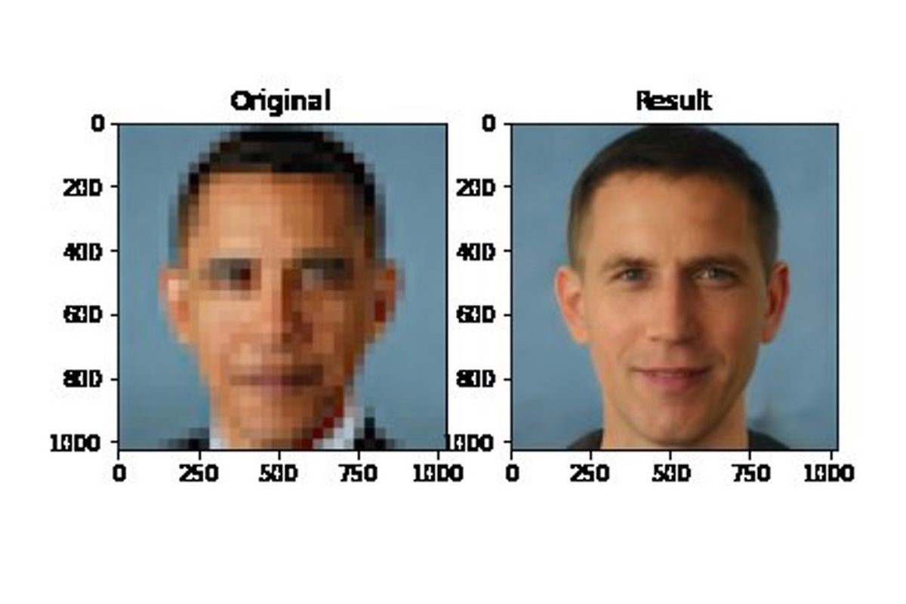
Who is this?

Slide 6
Data science is just one part of a whole system
Important to communicate with end users about types of bias in data, in models and model selection
Also important to engage with impacted or stakeholder groups for appraisal of data inputs and model outputs.

Slide 7
What does bias look like from a data science perspective?
Features or groups in a dataset are more heavily weighted or represented than others, leading to skewed outcomes (and low accuracy)
Models trained on skewed data have differential performance for different groups of people
I.e. a model trained on a dataset of mostly men might perform badly for women
Bias in -> Bias out

Slide 8
Many sources of bias...
Confirmation bias
seeking out new evidence that confirms previously held beliefs
Mitigation: try to find counter-examples
Selection bias
samples from a population are unrepresentative of the whole
Mitigation: compare samples to overall pop and test model performance on specific subgroups
Historical bias
historical and or social prejudices and beliefs are reflected in data.
Mitigation: engagement with affected groups / resampling data
Survivorship bias
focusing on characteristics of salient examples rather than whole populations
Mitigation: look at all possible outcomes, not just notable outcomes
Reporting bias
Datasets based around only recording noteworthy events

Slide 9
Definitions of fairness
Procedural fairness – making sure the process / model doesn't include explicit discrimination in the decision making
Outcome fairness – checking outcomes of a process / model to audit for fairness not only in the decision making process but the actual decisions made
Group fairness - diverse groups of people should be treated the same on average. This could mean applying the analysis to everyone in the same way.
Individual fairness - individuals who are similar should be treated similarly. This could mean that a model applied to two people who have similar features, should give similar predictions/results, I.e., fairness through awareness

Slide 10
Example scenario
Suppose we are building an algorithm that predicts whether a given individual is likely to go missing in the next 6 months
Questions to explore:
Who are the end users?
What are they most concerned about in terms of bias? Protected characteristics?
Which groups might be especially affected by bias?
What is their definition of fairness?

Slide 11
Example Scenario continued:
Suppose we found that the end user was particularly concerned about gender bias and so that is an important characteristic to explore. First, we look at the results in the test dataset:
What is the overall performance of the model?
What is the performance of the model for men? What about for women?
Are the performances for these two groups significantly different from the overall performance? If so, it suggests a gender bias in the model
Define significance

Slide 12
Case study example
Description: There's recently been a severe storm and many areas have been badly damaged. The damage has caused people to lose homes, jobs and other property. The National Emergency Relief Agency is exploring the use of social media data to assess the damage and determine where to intervene with what types of resources at what level.
Goal: Accurately assess damage and send appropriate relief resources
Data: twitter posts, FaceBook posts geocoded with lat-long within disaster area and keywords/hashtags related to the storm
Analysis: intensity and type of damage by neighbourhood
Actions: assessment and allocate relief effort (type and amount)

Slide 13
What are the sources of bias?
How might these manifest in the data?
What are the downstream risks to fairness if we apply this model? I.e. how could bias impact the outcome?

